Slide 1

NEXUS 2.0
TITLE PAGE
Team Name: Neural Nomads
Problem Statement: AI-Powered Medical Billing Auditor & Insurance Appeal Engine for India
Team Members: Viraj Jadhao, Bhumi Sirvi

Slide 2
THE PROBLEM
Neural Nomads
The Healthcare Financing Crisis in India
Opaque. Complex. Exploitative.
Healthcare billing and insurance systems in India lack transparency, leading to unchecked overcharges and denied claims.
A patient in Pune was billed ₹2,200 for a procedure priced at ₹800 under CGHS norms — and had no way to know.
50Cr
8M
Why This Gap Exists?
Insured Population
Annual Claim Denials
Non-standardized and highly complex hospital billing formats that vary between institutions
Lack of accessible interpretation of IRDAI regulations and compliance requirements
Absence of automated tools that can analyze bills and generate evidence-based appeals
67%
₹8K-15K
Never Appealed
Average Overcharge
Our Solution
What We Do: AI system that audits bills and auto-generates insurance appeals.
MedGuard AI uploads your hospital bill, flags every overcharge against CGHS rates, and auto-generates a legally grounded IRDAI-compliant appeal letter — in under 15 seconds.
NEXUS 2.0
No tool exists in India that does thisa Until now.
1

Slide 3
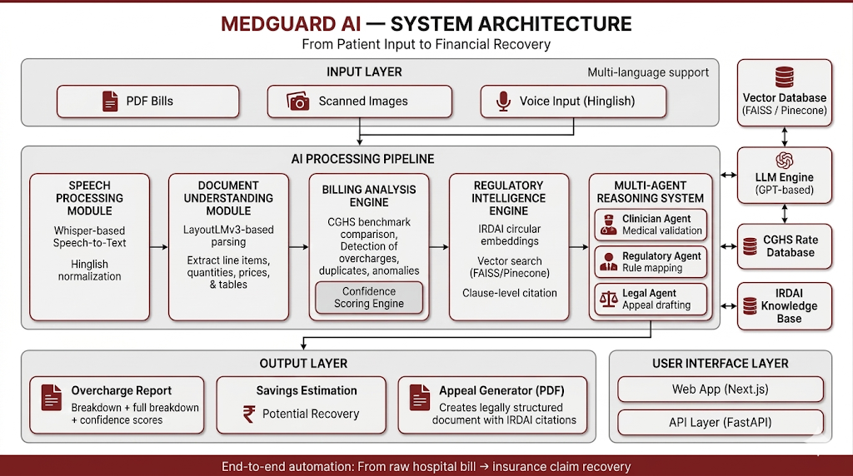
TECHNICAL APPROACH
Neural Nomads
Tech Stack Overview:
Layer | Technologies
Frontend | Next.js, Tailwind, ShadCN
Backend & APIs | FastAPI, API Gateway, Celery, Redis
AI Core | Whisper, LayoutLMv3, GPT Models
Data Layer | PostgreSQL, S3, FAISS / Pinecone
Output | ReportLab, Jinja2
Infrastructure & DevOps | Docker, Vercel, AWS, GitHub Actions, Razorpay
2
NEXUS 2.0

Slide 4
FEASIBILITY & VIABILITY
Neural Nomads
Feasibility:
Viability:
Aspect | Key Points
Proven Technology Stack | Whisper, LayoutLMv3, GPT — production- ready
Data Availability | CGHS rates + IRDAI regulations (public, updatable)
Build Status | AdvocAI appeal pipeline live — ClaimShield layer in active development
Processing Performance | ~15s processing, cloud-native
System Accessibility | PDFs, images, Hinglish voice input
Risk & Mitigation | Extend CGHS with NABH/private benchmarks
Aspect | Key Points
Market Opportunity | 50Cr insured, 8M denials, 67% unchallenged
Revenue Model | ₹99/appeal + SaaS + API integrations
User Value Proposition | ₹8K–₹15K savings per bill
Market Capture Potential | Even 0.1% → 5K+ cases/year
Competitive Advantage | CGHS + IRDAI + Hinglish + automated appeals
Scalability & Expansion | Fraud detection, compliance, claims automation
Sustainability | Periodic IRDAI + CGHS updates
Built on public government data. Cloud-native. Zero dependency on proprietary hospital systems.
NEXUS 2.0
Phase 1 live: May 2, 2026 | GitHub: github.com/Viraj281105/Advocai
3

Slide 5
IMPACT & BENEFITS
Neural Nomads
Transforming Healthcare Financial Protection
What changes for 50 crore Indians:
MedGuard AI bridges the gap between complex healthcare billing and patient financial protection—enabling fast, accurate, and accessible recovery of unjustified charges.
⏱ 15 seconds. From raw hospital bill to legally grounded appeal letter.
1.
2.
Accessibility First
Accuracy Through AI
Hinglish voice input + English/Hindi text — covers 600M+ Hindi speakers with zero technical barrier
87%+ confidence scoring on every flagged overcharge — not just a flag, but a probability
3.
4.
Speed at Scale
Savings Visibility
~15s processing vs hours/days → instant actionable insights
vs. 3–7 days with a medical lawyer costing ₹3,000–₹8,000
Average ₹12,400 potential recovery surfaced per bill — shown instantly, not buried in a report
67% of patients never appeal. MedGuard AI makes that number zero.
NEXUS 2.0
4

Slide 6
References
Neural Nomads
Source | Category | Role in MedGuard AI | Link
CGHS (Govt. of India) | Pricing Benchmark | Standard rates used to detect hospital overcharges | https://cghs.mohfw.gov.in
IRDAI | Insurance Regulation | Defines claim rules, approvals, and appeal frameworks | https://www.irdai.gov.in
IRDAI Annual Reports | Market Data | Provides claim denial rates and insurance trends | https://irdai.gov.in/annual-reports
National Health Authority (Ayushman Bharat) | Public Coverage Data | Validates scale of insured population in India | https://nha.gov.in
NDHM (Digital Health Mission) | Health Infrastructure | Supports digital health ecosystem & interoperability | https://ndhm.gov.in
NABH | Hospital Standards | Reference for private hospital practices (future benchmarking) | https://nabh.co
WHO (Health Financing) | Global Context | Validates need for transparency in healthcare financing | https://www.who.int/health-topics/health-financing
World Bank Health Data | Economic Validation | Supports macro-level healthcare spending insights | https://data.worldbank.org
5
NEXUS 2.0

